Slide 1
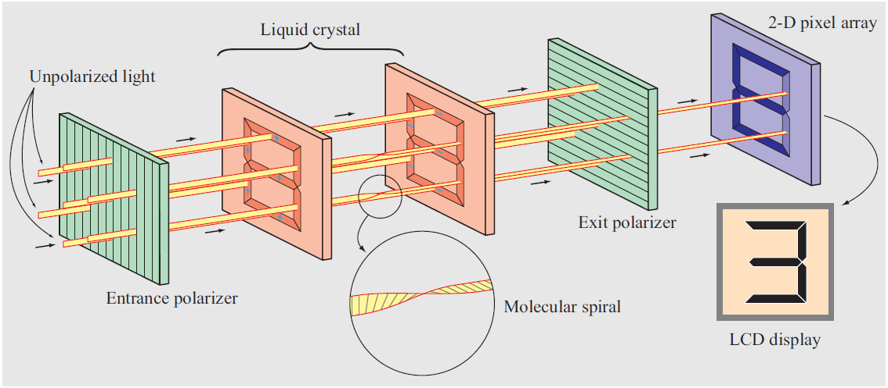
1. Waves & Phasors
2-D Array of a Liquid Crystal Display
Applied EM by Ulaby, Michielssen and Ravaioli

Slide 2
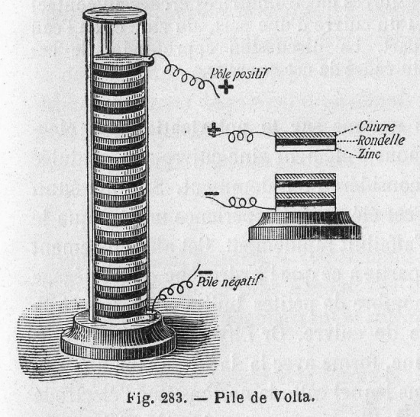
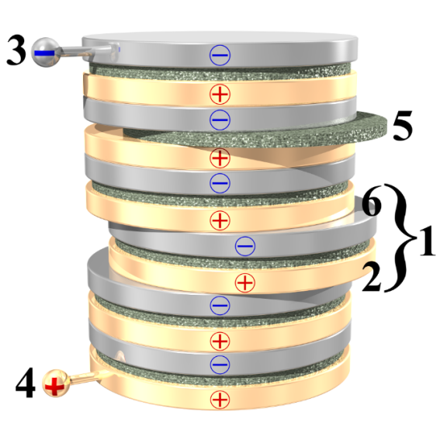
Electricity – Alessandro Volta
In 1800, Alessandro Volta invented the voltaic pile, which for the first time provided a reliable source of electricity
The SI unit for electric potential (voltage) is named after him: volt (V)
Volta was the first to realize the relationship between the electric potential and the amount of charge an object can hold, giving rise to the concept of capacitance

Slide 3
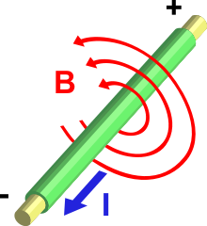
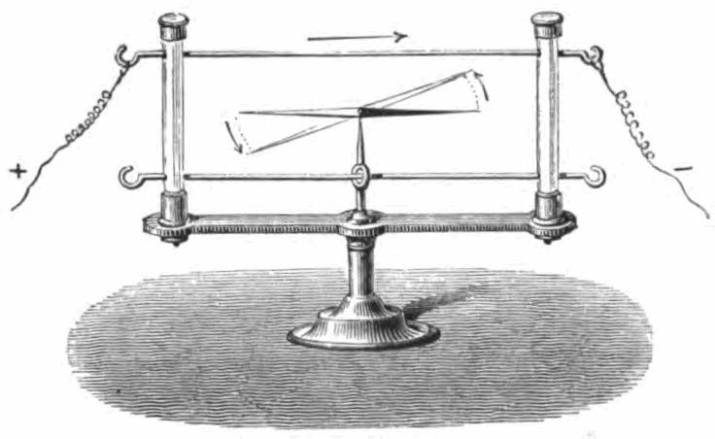
Electromagnetism
In 1820, Hans Christian Ørsted discovered that a compass needle could turn its direction from north when an electric current is turn on nearby
André-Marie Ampère further showed that showed that two parallel wires carrying electric currents attract or repel each other, depending on whether the currents flow in the same or opposite directions, respectively
Ampère also formulated the mathematics explaining the physics of electromagnetism

Slide 4
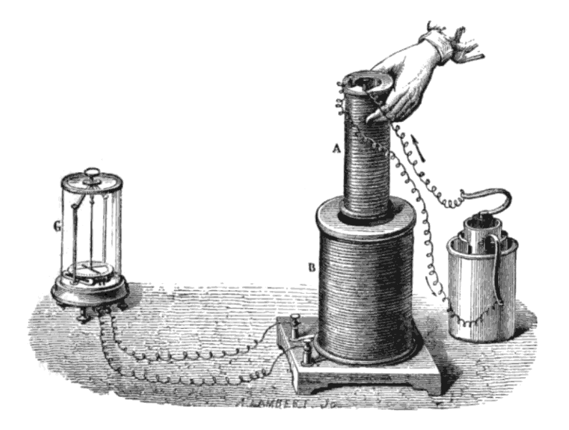
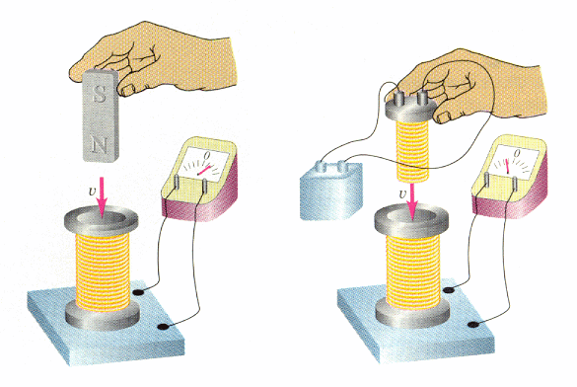
Electromagnetic Induction
Around 1831, Michael Faraday experimentally demonstrated that a moving magnet can induce electric voltage
This gives a big clue about the unification of electricity and magnetism
This also lead to the invention of electric generator
Faraday also demonstrated mutual induction, electric motor, and proposed the concept of electromagnetic “field” --- an interaction that extends beyond physical contact

Slide 5
Chapter 1 Overview
Electric Charge and Field
Magnetic Field
EM Waves and Basic Concepts
Complex Numbers
Phasor

Slide 6
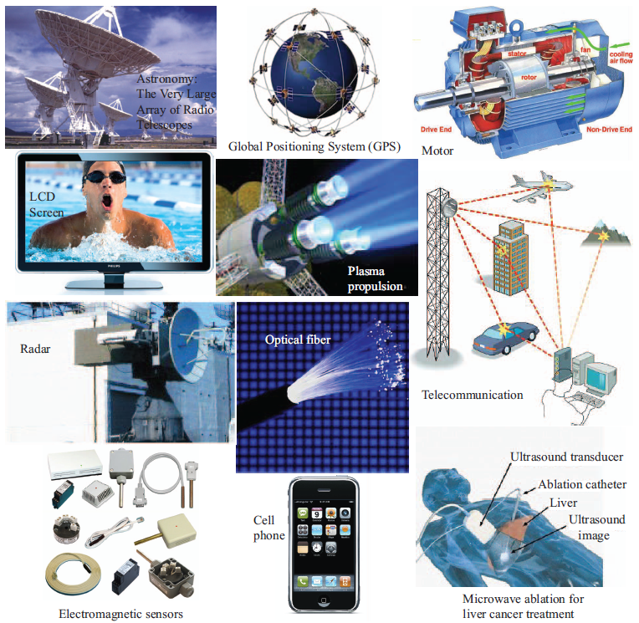
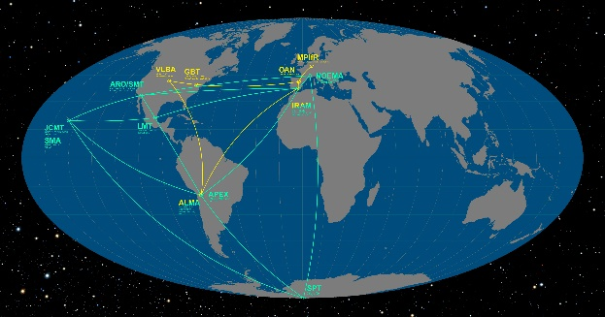
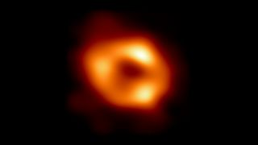
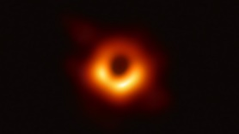
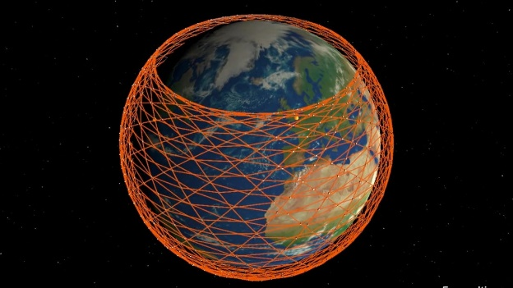
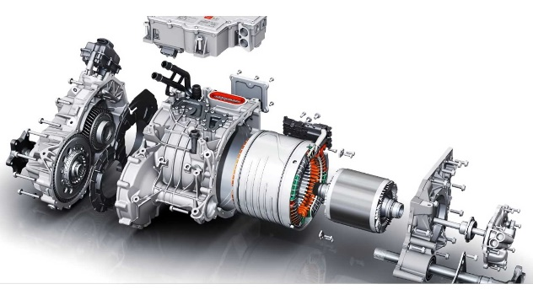
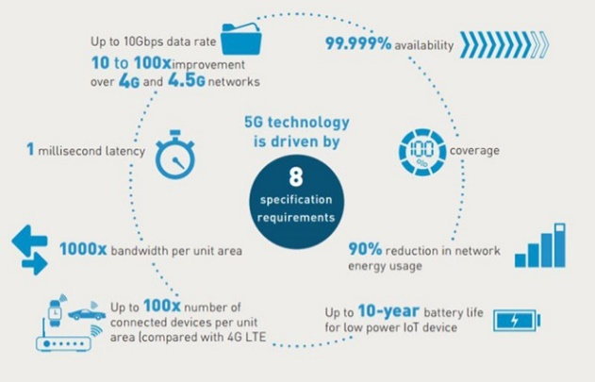
Examples of EM Applications
Event Horizon Telescope
Starlink
Tesla Motor

Slide 7
Charge: Electrical property of particles
Units: coulomb
One coulomb: amount of charge accumulated in one second by a current of one ampere.
1 coulomb represents the charge on ~ 6.241 x 10¹⁸ electrons
The coulomb is named for a French physicist, Charles-Augustin de Coulomb (1736-1806), who was the first to measure accurately the forces exerted between electric charges.
Charge of an electron
e = 1.602 x 10⁻¹⁹ C
Charge conservation
Cannot create or destroy charge, only transfer

Slide 8
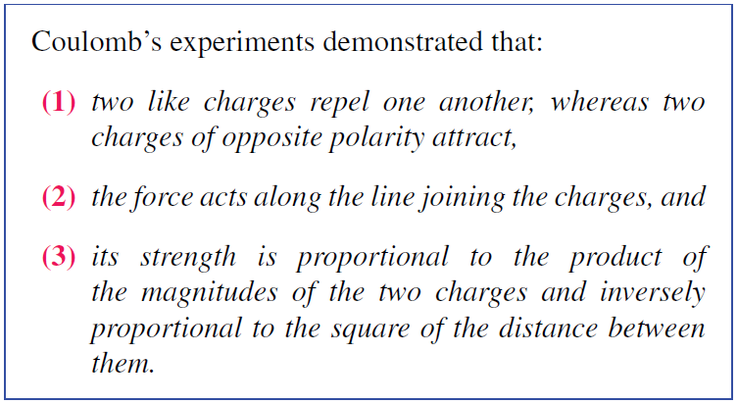
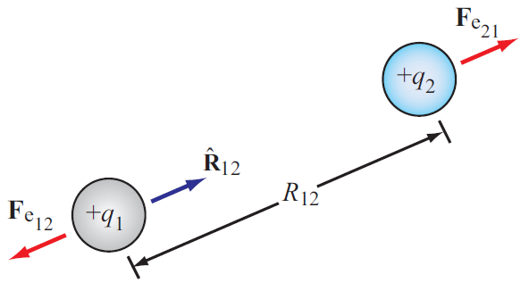
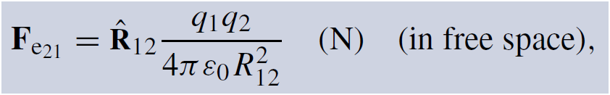
Electrical Force
Force exerted on charge 2 by charge 1

Slide 9
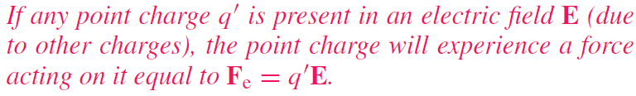
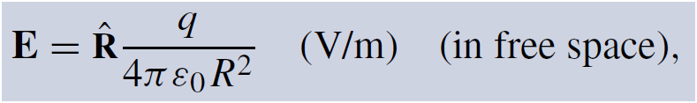
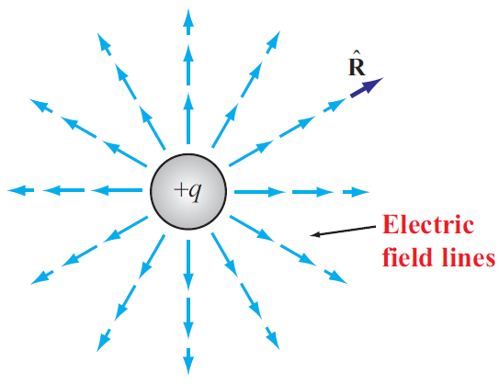
Electric Field In Free Space
Permittivity of free space

Slide 10
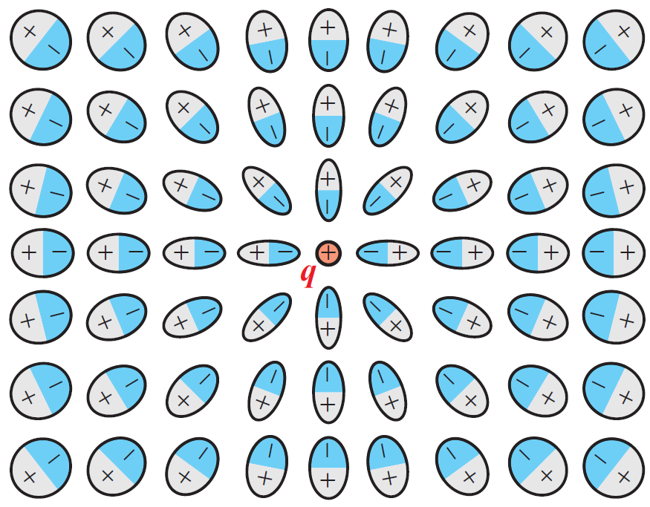
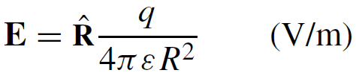
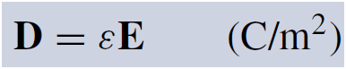
Electric Field Inside Dielectric Medium
Polarization of atoms changes electric field
New field can be accounted for by changing the permittivity
Permittivity of the material
Another quantity used in EM is the electric flux density D:

Slide 11

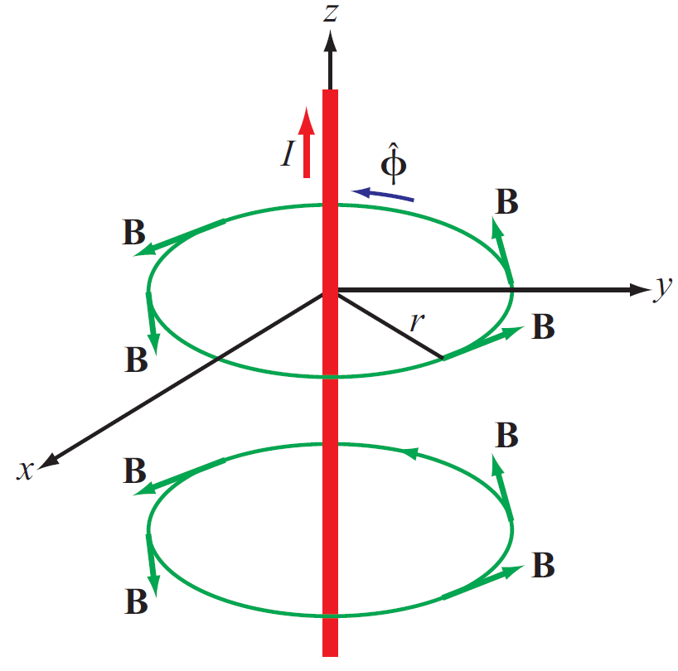
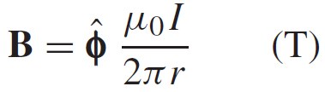
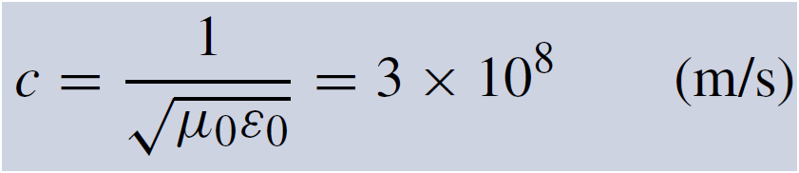
Magnetic Field
Electric charges can be isolated, but magnetic poles always exist in pairs.
Magnetic field induced by a current in a long wire
Magnetic permeability of free space
Electric and magnetic fields are connected through the speed of light:

Slide 12
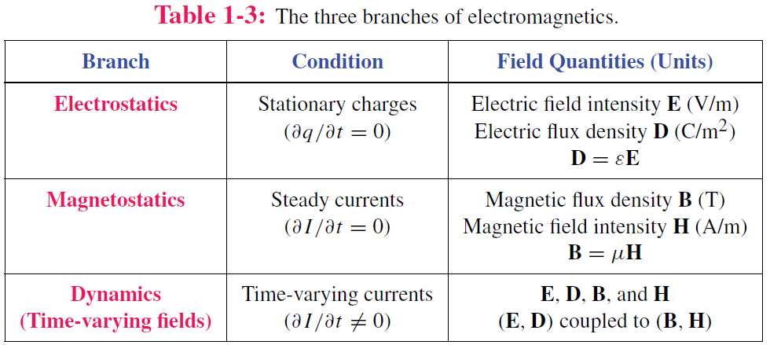
Static vs. Dynamic
Static conditions: charges are stationary or moving, but if moving, they do so at a constant velocity.
Under static conditions, electric and magnetic fields are independent, but under dynamic conditions, they become coupled.

Slide 13
Traveling Waves
Waves carry energy
Waves have velocity
Many waves are linear: they do not affect the passage of other waves; they can pass right through them
Transient waves: caused by sudden disturbance
Continuous periodic waves: repetitive source

Slide 14
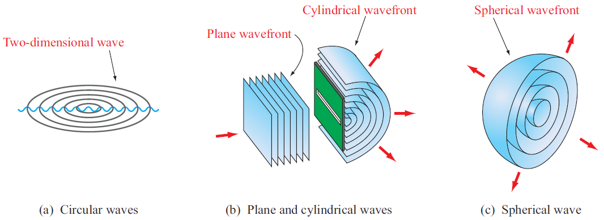
Types of Waves

Slide 15
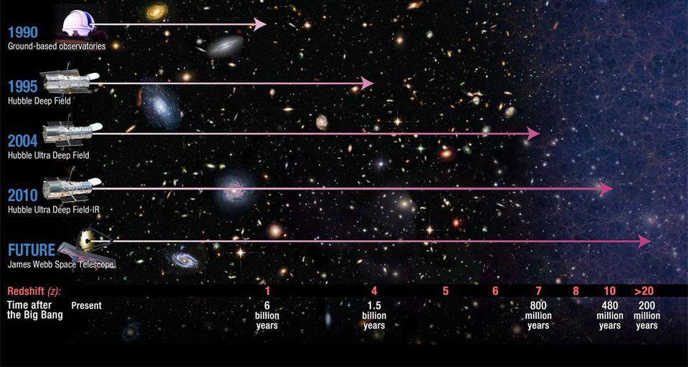
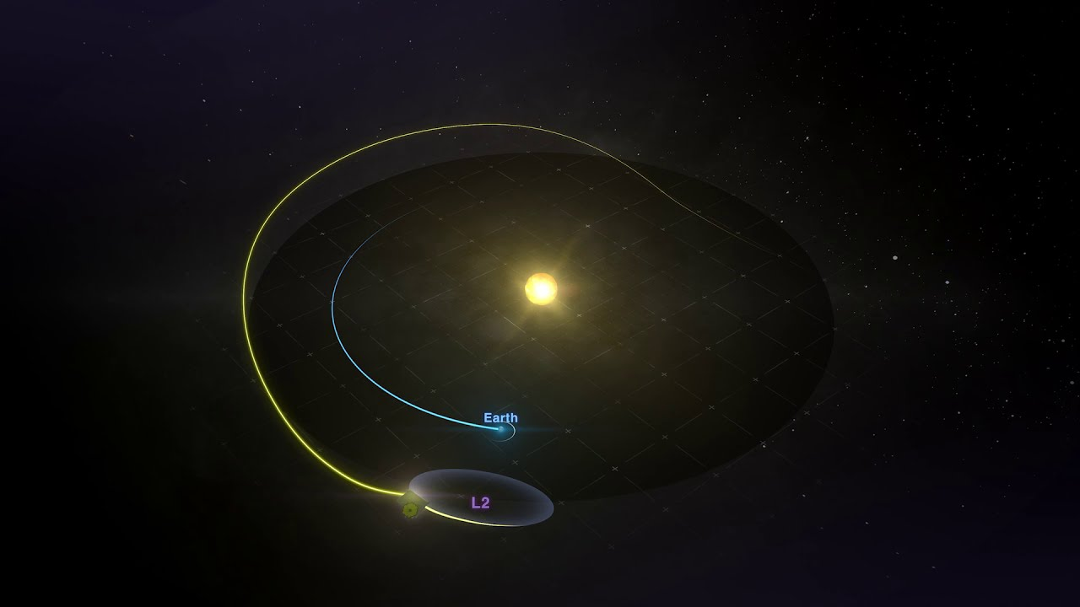
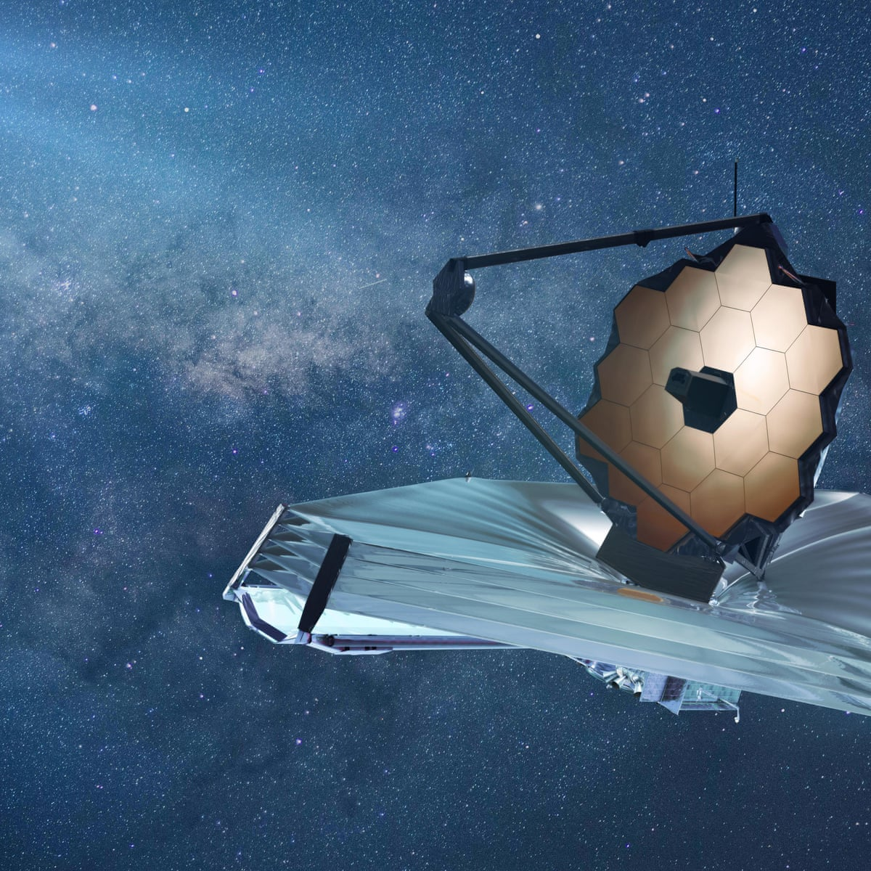
Waves can travel far

Slide 16
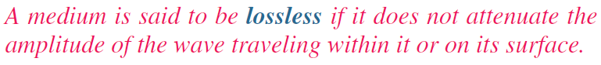
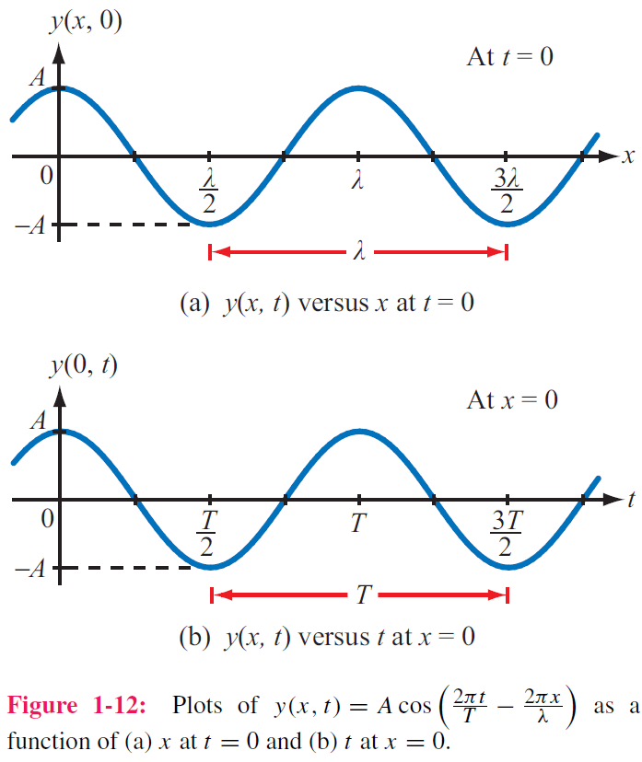
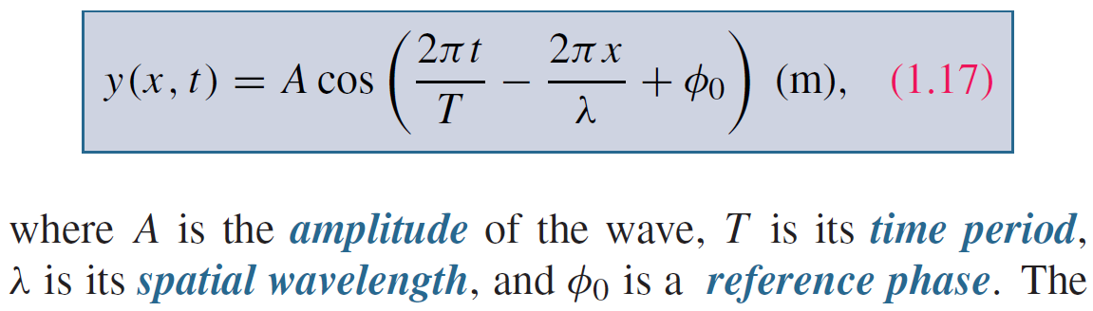
Sinusoidal Waves in Lossless Media
y = height of water surface
x = distance

Slide 17
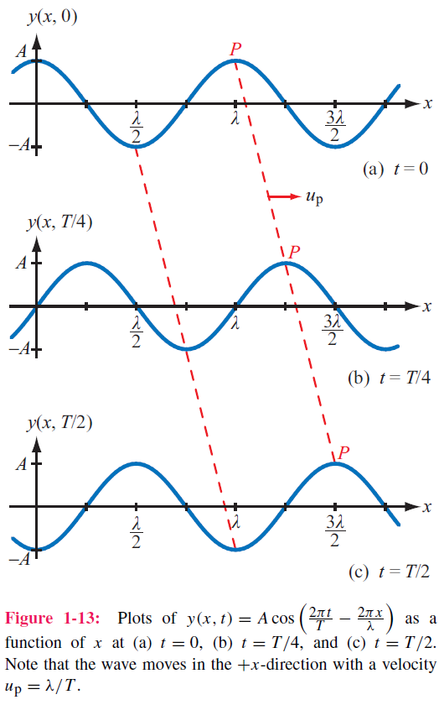
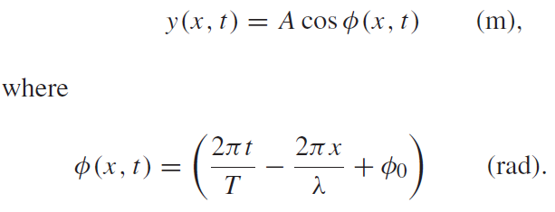
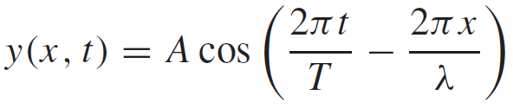
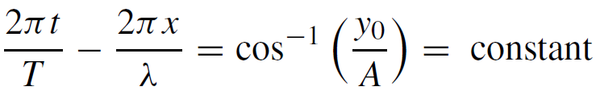
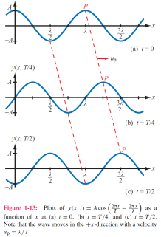
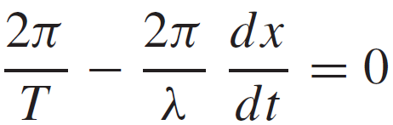
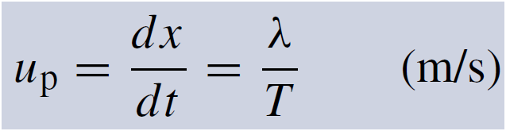
Phase velocity
If we select a fixed height y₀ and follow its progress, then
=

Slide 18
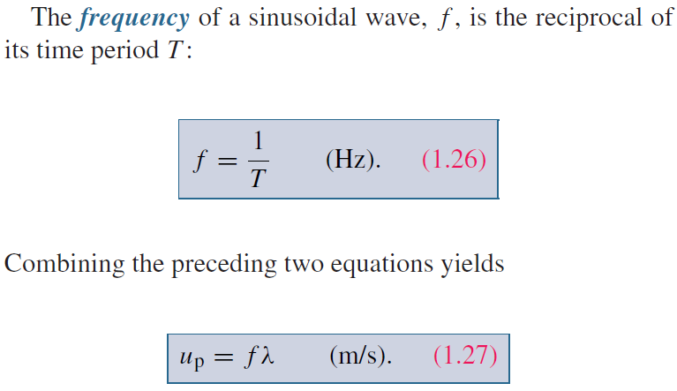
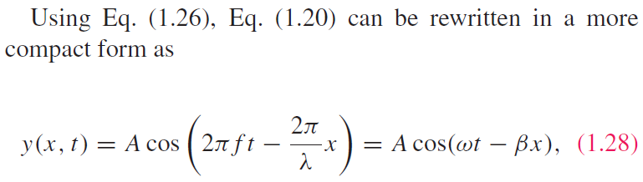
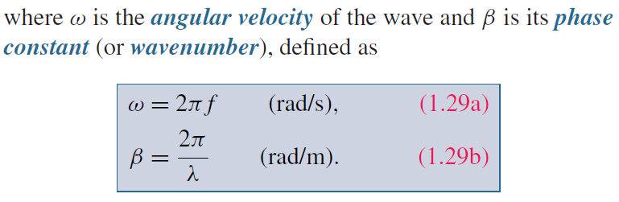
Wave Frequency and Period

Slide 19
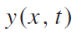
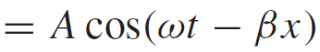
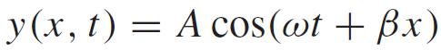
Direction of Wave Travel
Wave travelling in +x direction
Wave travelling in ‒x direction
+x direction: if coefficients of t and x have opposite signs
‒x direction: if coefficients of t and x have same sign (both positive or both negative)

Slide 20
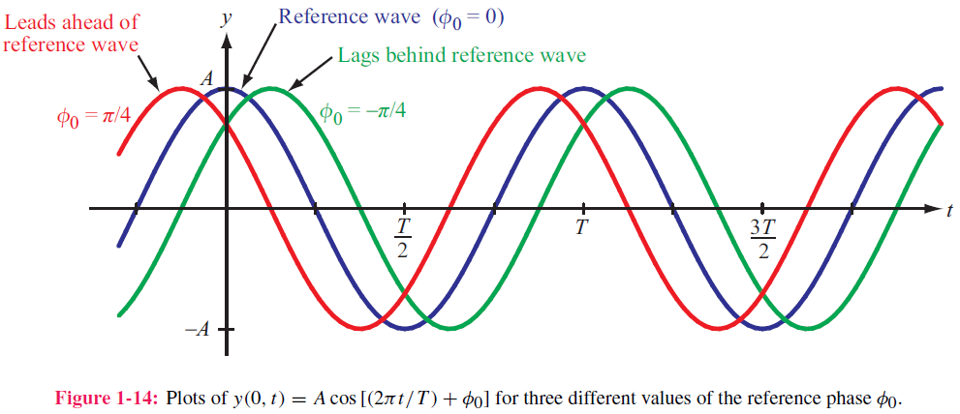
Phase Lead & Lag

Slide 21
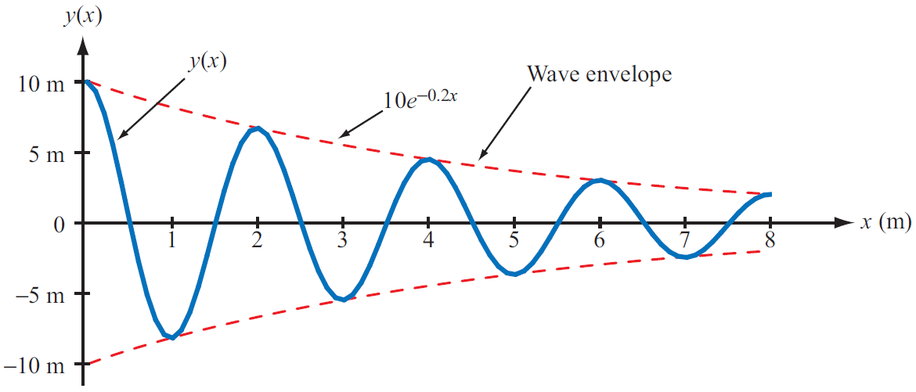
Wave Travel in Lossy Media
Attenuation factor

Slide 22
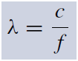

The EM Spectrum

Slide 23

Complex Numbers
We will find it is useful to represent sinusoids as complex numbers
Rectangular coordinates
Polar coordinates
Relations based on Euler’s Identity

Slide 24

Relations for Complex Numbers
Learn how to perform these with your calculator/computer

Slide 25

Phasor Domain
1. The phasor-analysis technique transforms equations
from the time domain to the phasor domain.
2. Integro-differential equations get converted into
linear equations with no sinusoidal functions.
3. After solving for the desired variable--such as a particular voltage or current-- in the phasor domain, conversion back to the time domain
provides the same solution that would have been obtained had
the original integro-differential equations been solved entirely in the time domain.

Slide 26





Phasor Domain
Phasor counterpart of

Slide 27

Time and Phasor Domain
It is much easier to deal with exponentials in the phasor domain than sinusoidal relations in the time domain
Just need to track magnitude/phase, knowing that everything is at frequency ω

Slide 28


Phasor Relation for Resistors
Current through resistor
Time domain
Time Domain
Frequency Domain
Phasor Domain

Slide 29



Phasor Relation for Inductors
Time domain
Phasor Domain
Time Domain

Slide 30



Phasor Relation for Capacitors
Time domain
Time Domain
Phasor Domain

Slide 31







ac Phasor Analysis: General Procedure

Slide 32


Example 1-4: RL Circuit
Cont.

Slide 33


Example 1-4: RL Circuit cont.

Slide 34


